Slide 1
AU Project Overview

Slide 2
ba8641@sporcsubmit.rc.rit.edu
Sinteractive
Vmd
43
6:60:60
spack load py-amplpy

Slide 3
Data Sources
Linksbridge:
  Detailed_Demand_Forecast_data
    Countries and vaccines that participated in 2021 procurement
    Countries that are part of Gavi or PAHO
  Country-data
    All countries in ‘WHO Region’ = ‘AMR’ procure through PAHO, except USA
      and Canada

Slide 4
Data Sources
Most of the demand and pricing data was extracted from Linksbridge:

Slide 5
Gavi Market (no AU)
Exclude all countries in PAHO
'Current WB Status & Current Gavi Eligibility':
  ‘Gavi Eligible’
  ‘Gavi Fully Self-Financing’
  ‘Gavi Transitioning’
    Procure ALL their vaccines through Gavi
    Pay the same price per dose

Slide 6
Gavi Market (AU independent)
Exclude all countries with 'WHO Region'=
  AMR/AFR
'Current WB Status & Current Gavi Eligibility':
  ‘Gavi Eligible’
  ‘Gavi Fully Self-Financing’
  ‘Gavi Transitioning’
    Procure ALL their vaccines through Gavi
    Pay the same price per dose

Slide 7
Prices (1)
''99_PAHO_Pricing_data'':
    Minimum price per dose in 2021 (most economic vial size)
'910_UNICEF_Pricing_data':
    Minimum price per dose in 2021 (most economic vial size)
Ignore countries not in Gavi/PAHO
Calculate GNI-vaccine coefficients

Slide 8
Prices (2)
Use calculated vaccine/GNI coefficients:
  Mean GNI in PAHO
  Mean GNI in Gavi
    GNI in Gavi changes dramatically without AU countries
  Mean GNI in AU

Slide 9
Unknown Values
AU:
  Manufacturing capacity
    Not currently addressed
  Manufacturing costs
    Addressed through minimum prices
  Mandatory internal demand
    Factor determining what percentage of the AU demand must be fulfilled
    with AU-produced vaccines (0%, 25%, 50%, 75%, 100%)

Slide 10
AU Manufacturing
Vaccines offered
  Greatest Gavi Market Share:
      DtwP-HepB-Hib'
      'MR'
      'PCV13'
      'Rota'
      HiB
Vaccine prices:
  Baseline price = equivalent non-AU vaccine x α

Slide 11
AU Pricing
Hyperparameter α:
  Scenarios in which local manufacturing is more/less competitive
    than foreign production.
    90% to 200% of the MP of equivalent Gavi vaccine
    GRAPH OF AU CS per MinP

Slide 12
Notation

Slide 13
Mathematical Formulation: Social Surplus

Slide 14
Mathematical Formulation: Customer Surplus (CS) and Profits (PF)

Slide 15
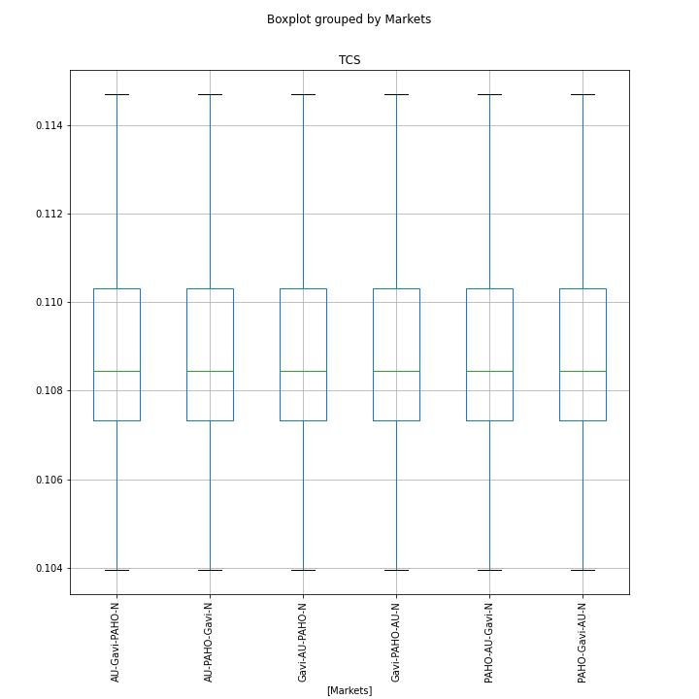
TCS in AU without production
Negotiation order is
irrelevant

Slide 16
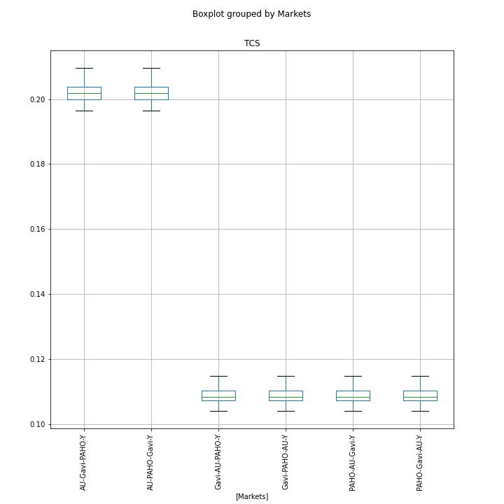
TCS in AU with production
AU, like all markets,
wants to negotiate first
regardless of minimum
prices

Slide 17

Relevant Factors

